Slide 1
A PARTNERSHIP
FOR SUCCESS

Slide 2
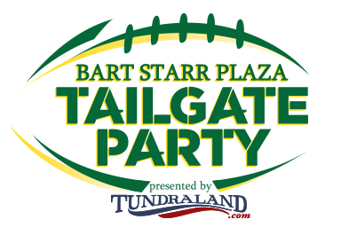
PMI ENTERTAINMENT GROUP
PMI Entertainment Group (PMI) is a Green Bay-based, non-stock, for-profit company that manages the Resch Center, Brown County Expo (opening January 2021) and Meyer Theatre. PMI owns the Green Bay Gamblers hockey club, Ticket Star, Celebrations Party & Event, and PMI Expo and Event Production. PMI also provides game day services at Lambeau Field and produces the Bart Starr Plaza Tailgate Party.
PMI Video

Slide 3
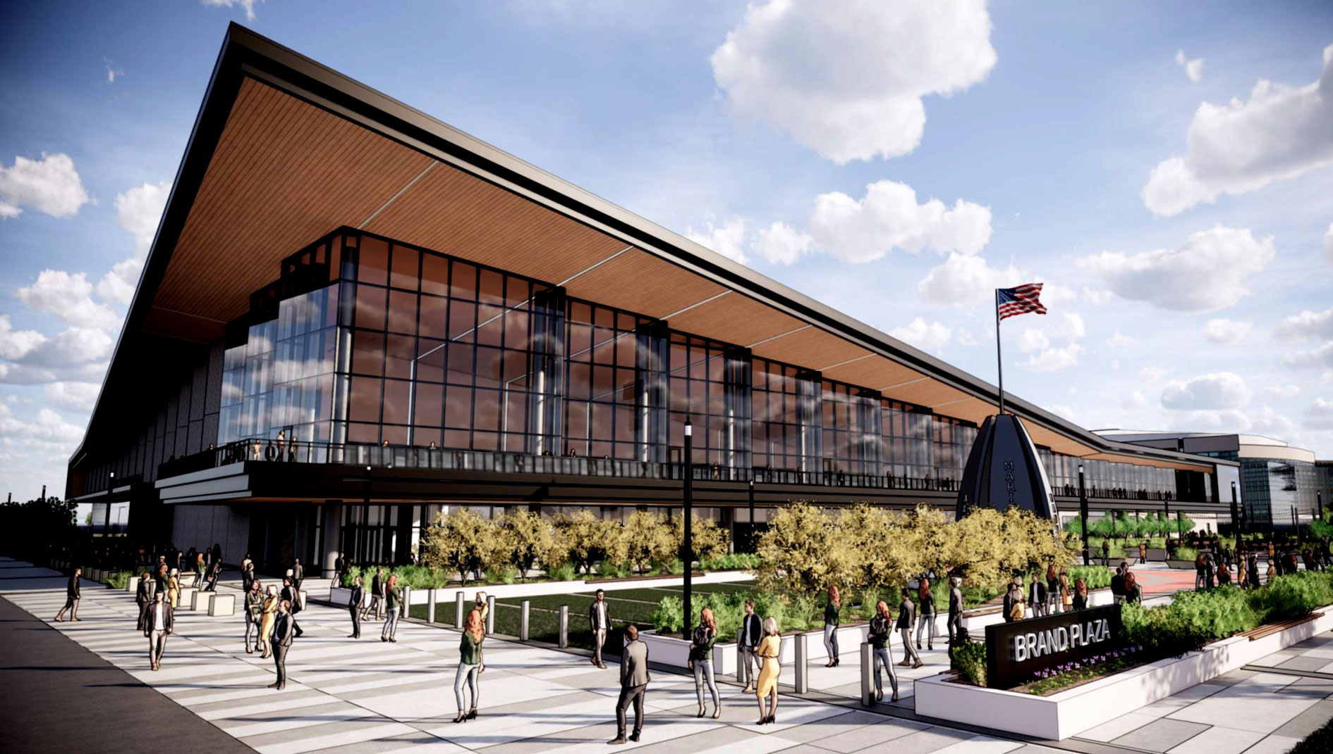
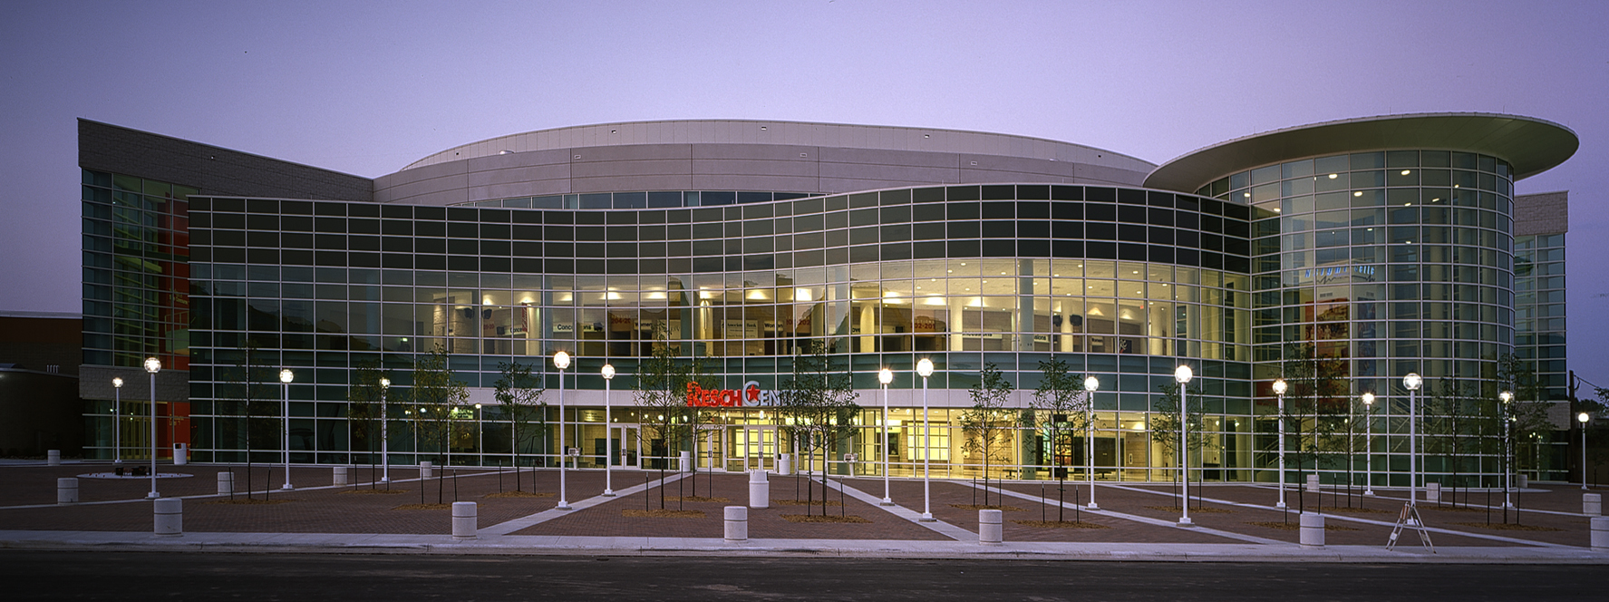
PMI ENTERTAINMENT GROUP
PMI was awarded the management of the county-owned Resch Center
arena in 2002, hosting more than 150 event days and hundreds of thousands
of visitors annually. The new Expo, due to open in January 2021,
is next to the arena and will also be managed by PMI. It’s 125,000
square feet of exposition, meeting and event space will be used for a wide
variety of trade and consumer shows and sporting events. Together these
venues are the heart of Green Bay’s entertainment district and the perfect
compliment to the Packers Titletown District.

Slide 4
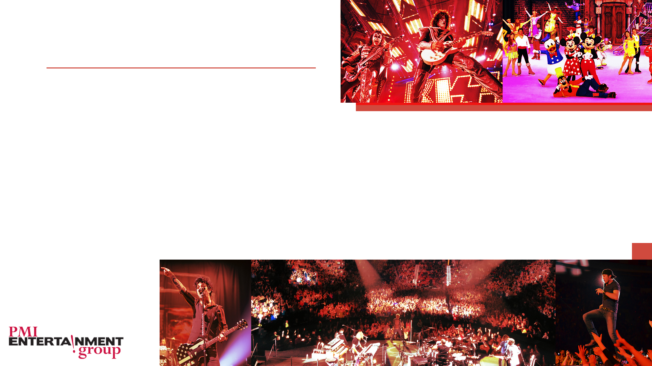
RESCH CENTER
Since it opened in 2002, the Resch Center has consistently been one of the busiest arenas in the Midwest, attracting hundreds of thousands of people for world class concerts, family shows and major sporting events.
Pollstar magazine has ranked the Resch Center in the top 200 arena venues in the world for ticket sales in 2019.
Venues Now lists the Resch Center as #5 in the Midwest ‘Top Stops’ ranking in the 10,001-15,000 capacity February1, 2018 – January 31, 2019.
Event History

Slide 5
RESCH CENTER SPORTS
Resch Center home teams include
Green Bay Gamblers Hockey – 30 home games
Green Bay Men’s Division One Basketball – 10 home games
Green Bay Blizzard Professional Indoor Football – 7 home games
Additional Sporting Events
WIAA Girls & Boys State Volleyball 20,000 attendees
WIAA Girls State Basketball 40,000 attendees

Slide 6
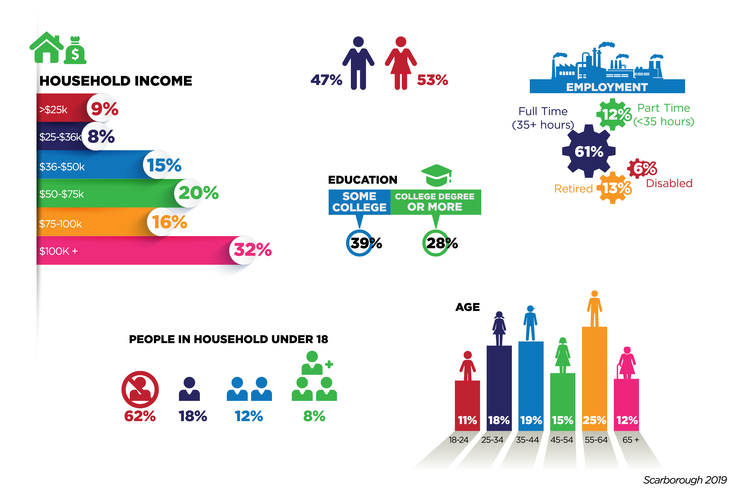
RESCH CENTER ATTENDEE PROFILE
Scarborough Data Demographics

Slide 7
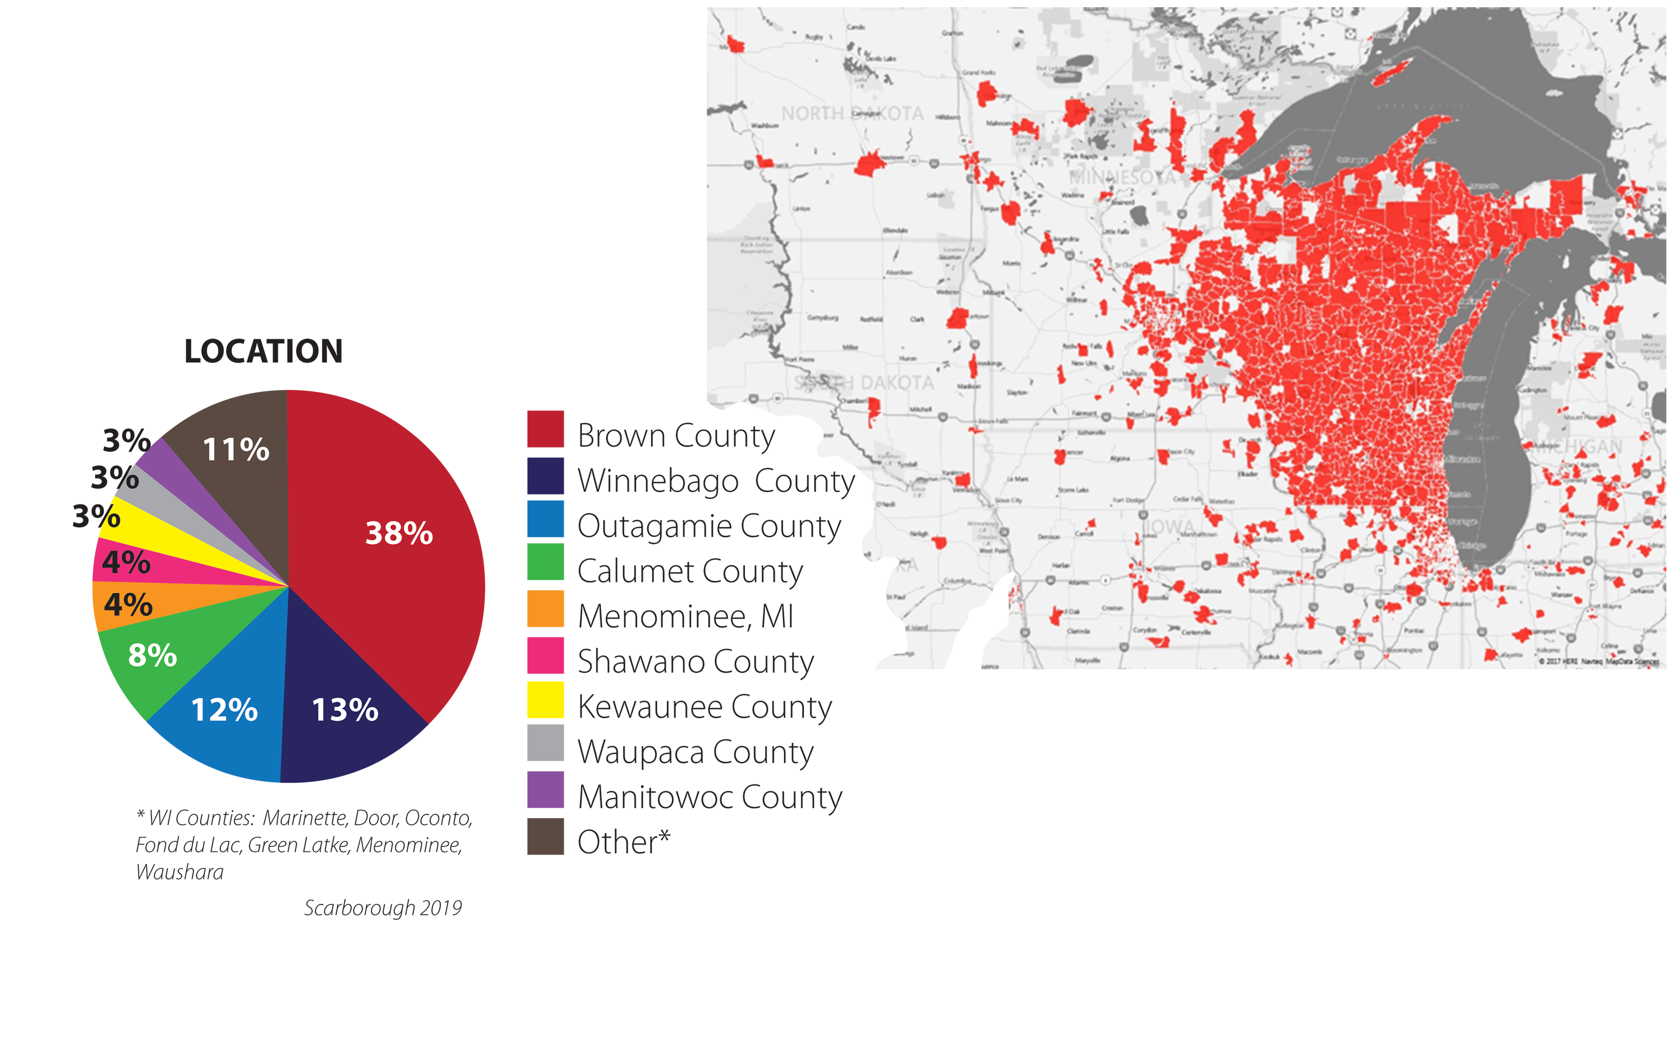
RESCH CENTER ATTENDEE PROFILE
Scarborough Data
Geographic

Slide 8
WEBSITE ANALYTICS
Google Analytics

Slide 9
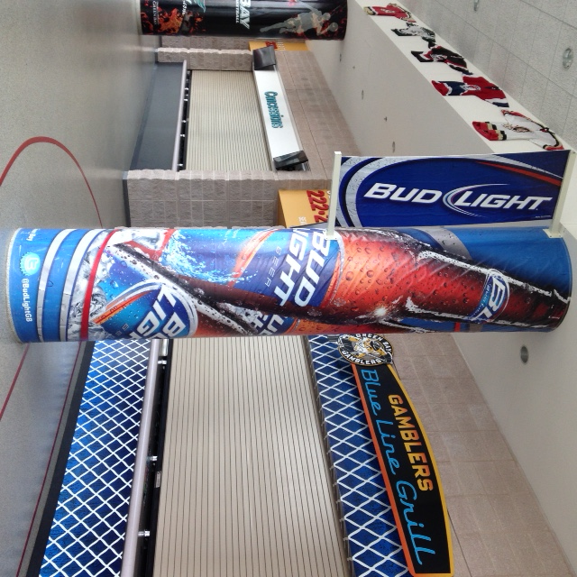
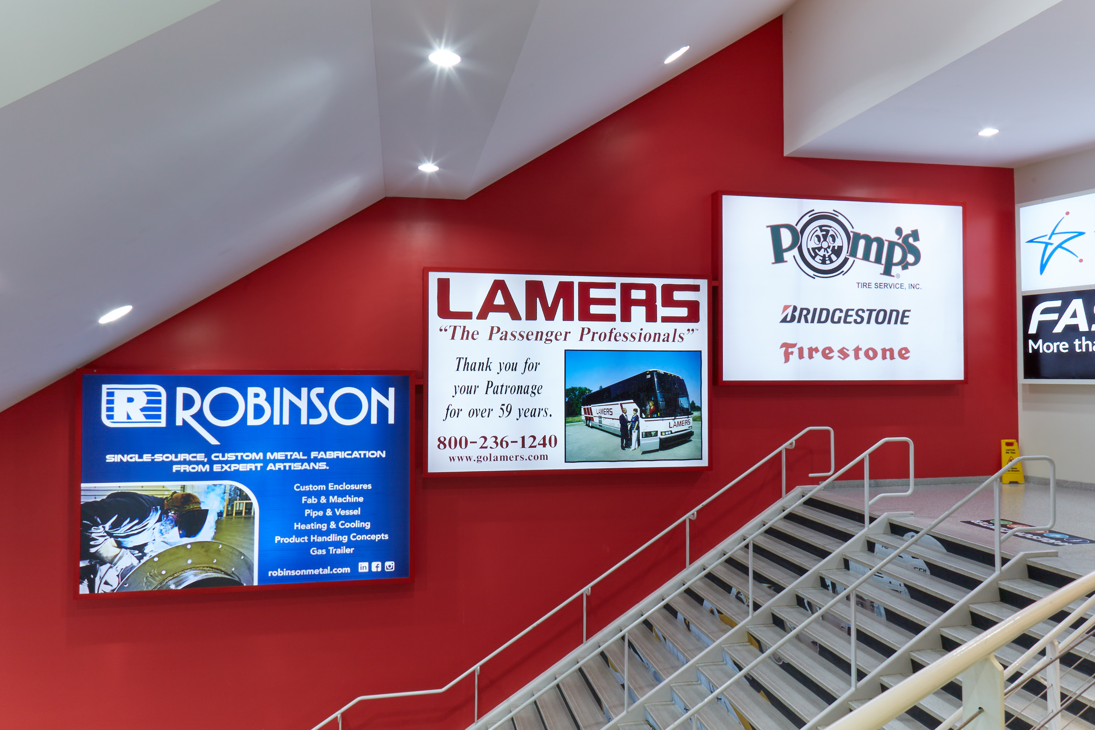
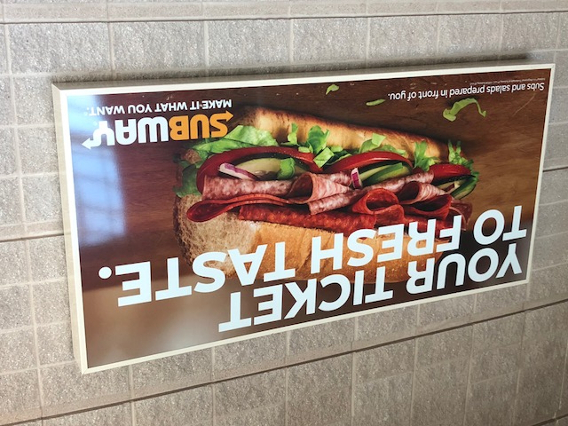
RESCH CENTER
SPONSORSHIP
Static Signage
Concourse/Stairwells
Pillar Wrap
Pillar Flag
4x8 Concourse Backlit
8x12 Stairwell Backlit

Slide 10
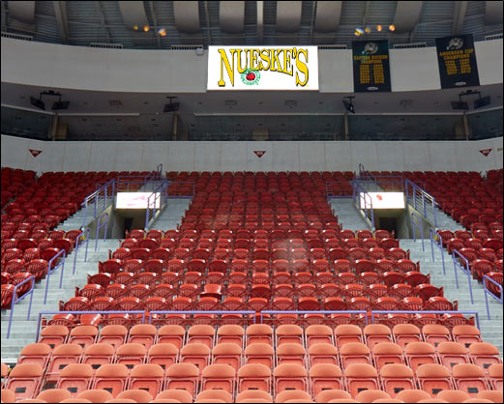
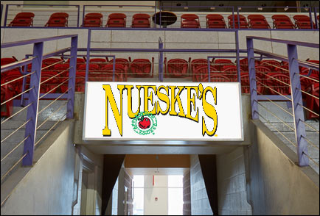
RESCH CENTER
SPONSORSHIP
Static Signage
Bowl
2x5 Bowl Backlit
8x18 Bowl Backlit

Slide 11
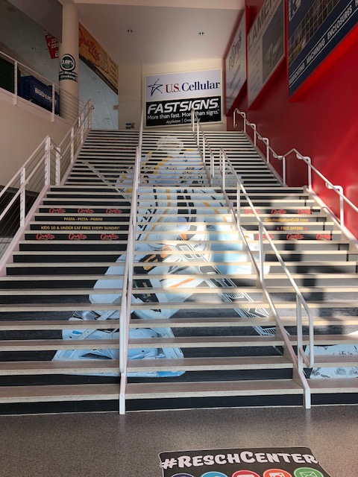
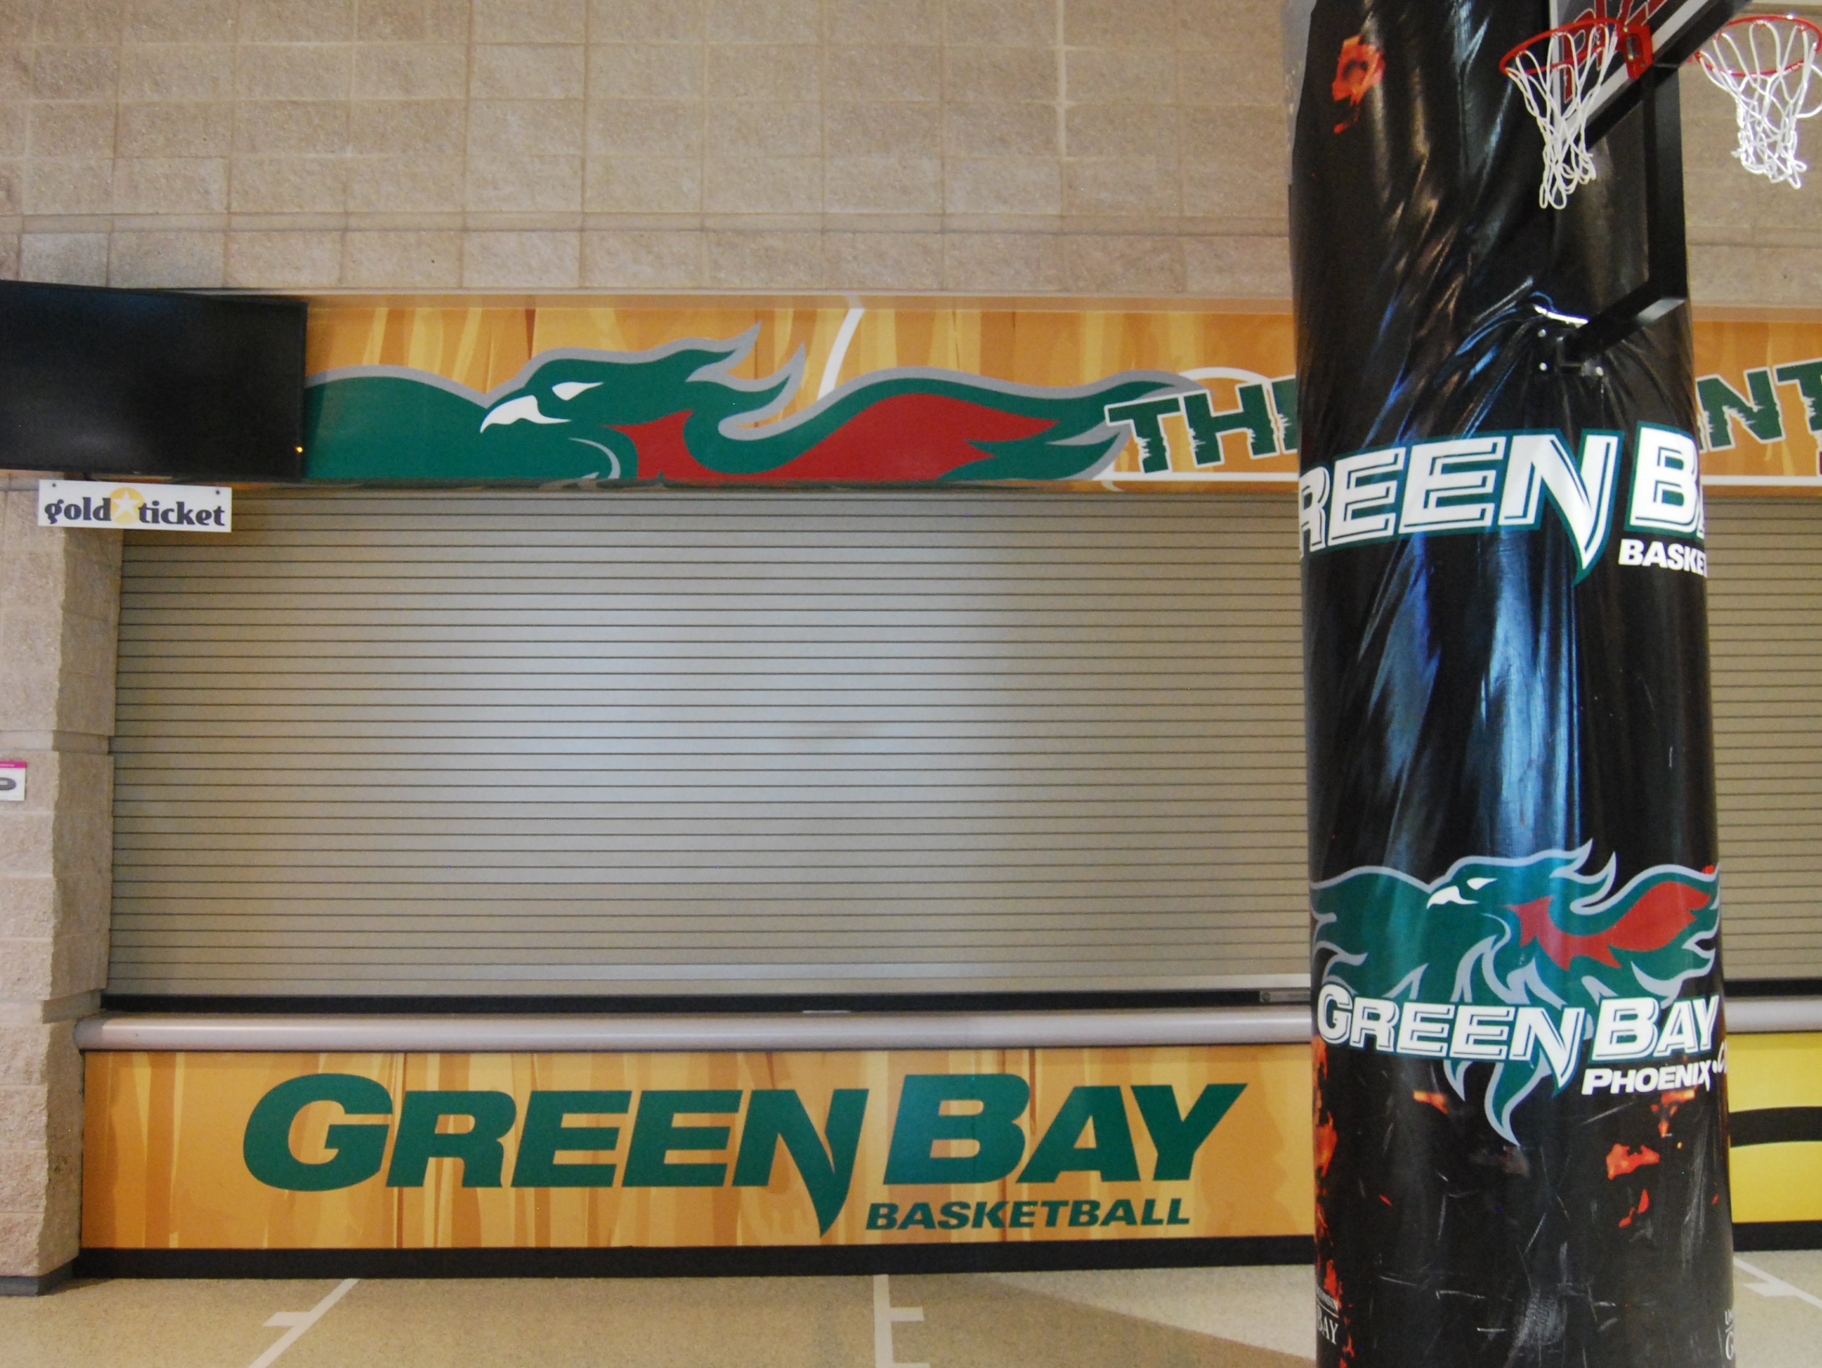
RESCH CENTER SPONSORSHIP
Static Signage - Customized

Slide 12
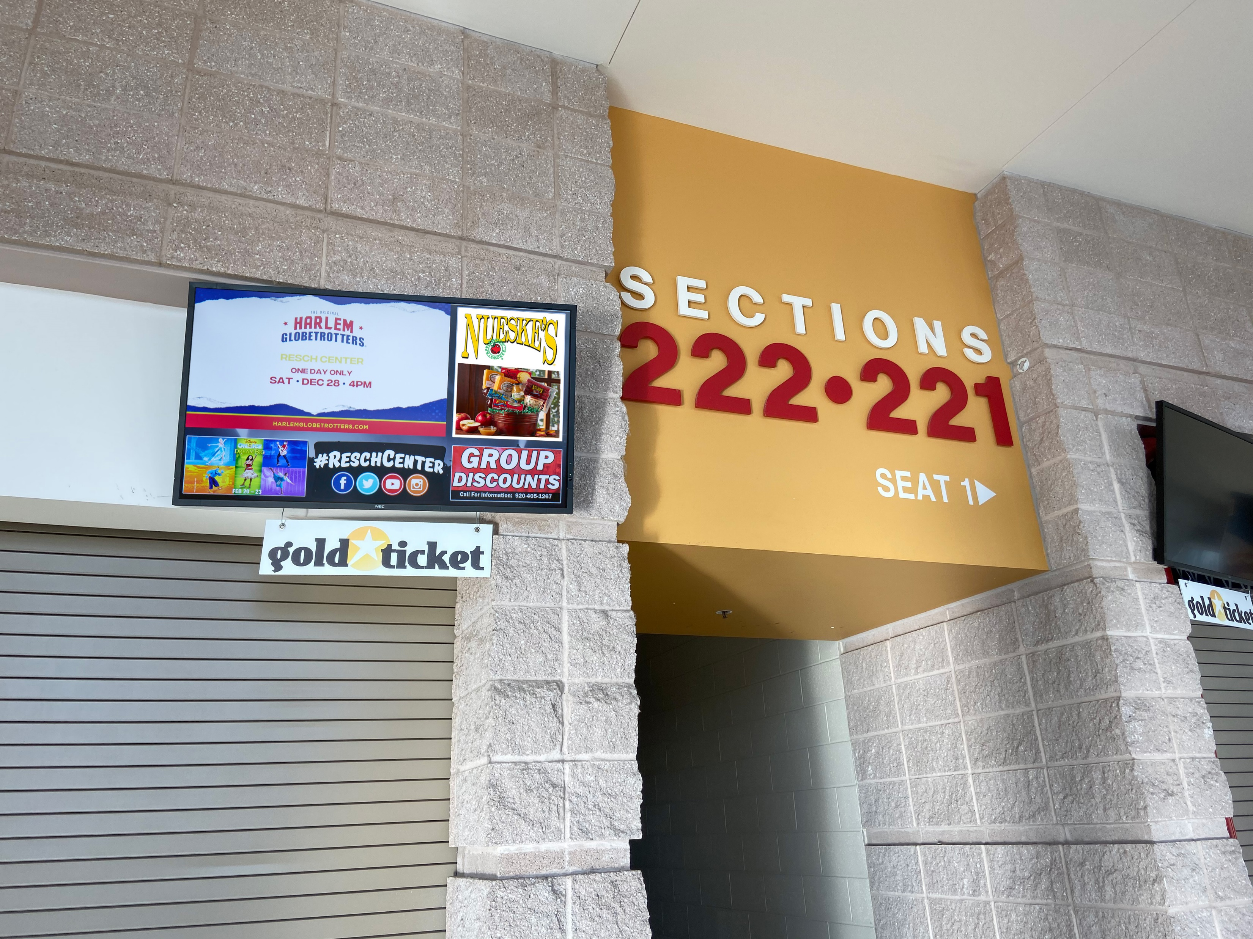
RESCH CENTER SPONSORSHIP
Digital Signage – Concourse Concession Stand TV’s
Maximum 30 second animation played in loop for all events at the Resch Center from doors open to close, some limitations may apply.
Minimum rotation of 10 times per hour with
option to change the animation with two-week notice.
Creative supplied by sponsor, audio not available.

Slide 13
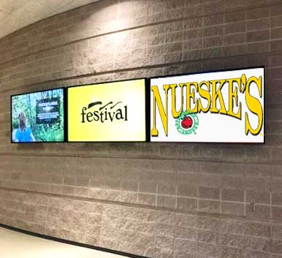
RESCH CENTER SPONSORSHIP
Digital Signage – 90” Concourse Displays
Three (3) HD Screens on Resch Center Concourse East & West.
Message on two (2) 90” digital concourse
screens (placed in highest traffic areas).
Maximum 15 second animation played in loop for all
events at the Resch Center from doors open to close,
some limitations may apply.
Minimum rotation of 40 times per hour per
concourse side (East & West)
Option to change the message with two-week notice.
Creative supplied by sponsor, audio not available.

Slide 14
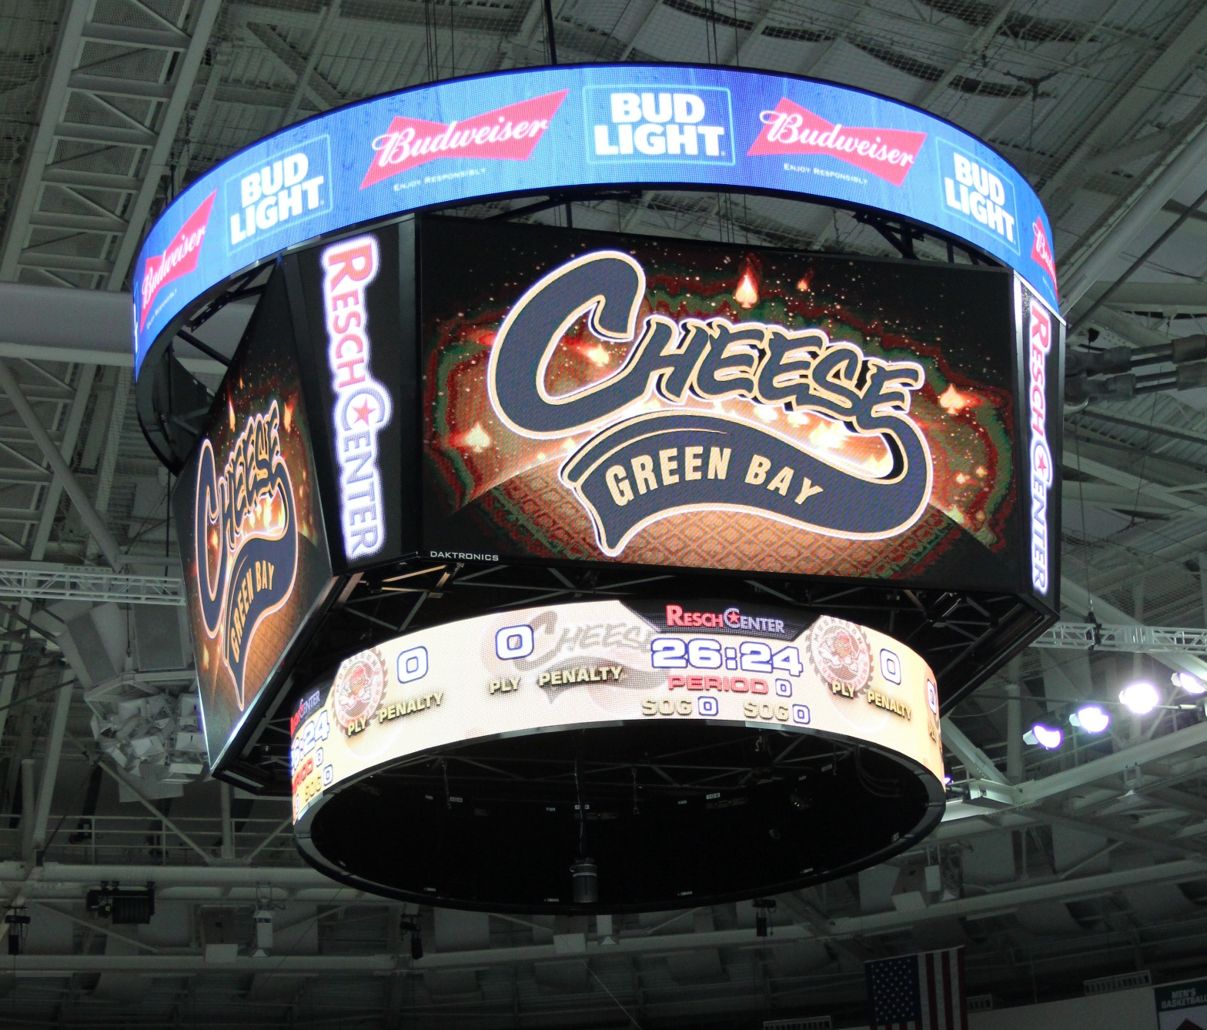
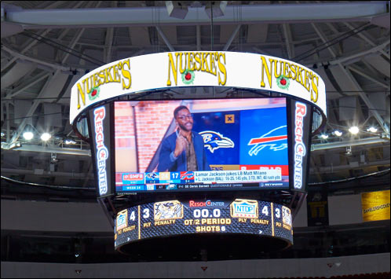
RESCH CENTER SPONSORSHIP
Digital Signage – Master Scoreboard
Animation played on top ring.
One (1) :15 or :30 animation
with minimum of 10 impressions per hour
for which the scoreboard is in operation, some
limitations may apply.
Resch Center events to include sports events,
i.e. Green Bay Gamblers, Green Bay Men’s
Basketball, Green Bay Blizzard, etc.
Creative supplied by sponsor, opportunity to
change monthly with two-week notice, audio
not available.

Slide 15
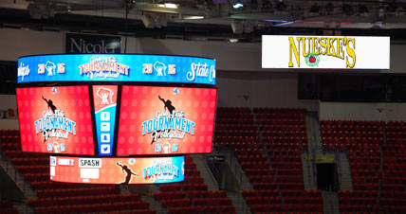
RESCH CENTER SPONSORSHIP
Digital Signage – Auxiliary Bowl Scoreboards
Animation played on Resch Center Auxiliary Boards.
Two (2) Auxiliary scoreboards/right panel/end zones.
One (1) :15 or :30 animation with minimum of
10 impressions per hour in rotation for which the
the scoreboard is in operation, some limitations do apply.
Creative supplied by sponsor, opportunity to change
monthly with two-week notice, audio not available.
Animation on top right panel to include select sporting
events, i.e. Green Bay Gamblers, Green Bay Men’s Basketball,
Green Bay Blizzard, etc.
Full screen animation for concerts, comedy shows based on
promoter approval.

Slide 16
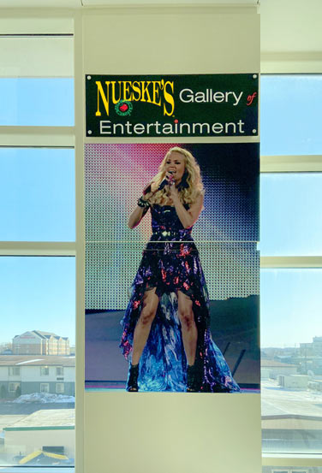
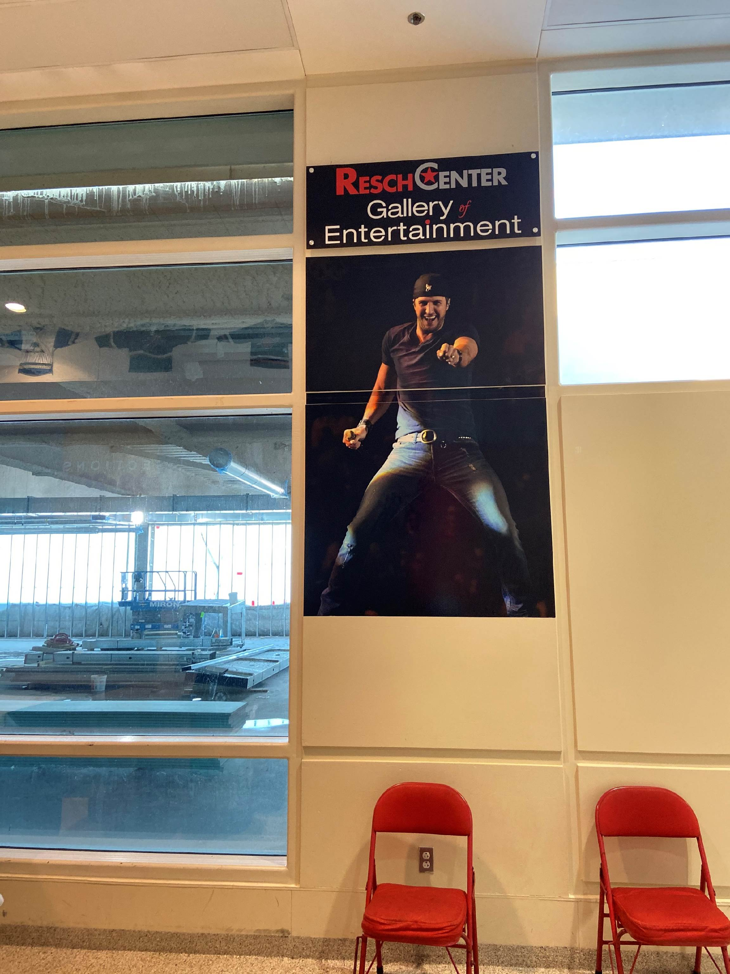
RESCH CENTER
SPONSORSHIP
Exclusive Naming Rights –
Entertainment Gallery
Sponsor logo on 8 event panels on Resch Center Concourse.
4 x 9 Event panels.
Logo supplied by sponsor.

Slide 17
RESCH CENTER SPONSORSHIP
Exclusive Naming Rights – Virtual Chat
Presenting sponsor of 24/7 customer-requested information PLUS this is an exclusive offer; no other sponsor will be associated with this service.
Over 2.5 million in traffic and 13.8 million-page views annually on ticketstaronline.com and reschcenter.com. Every page of each of the sites has a Chat display
Chats on the 2 websites will include “Powered by Sponsor”. In addition, the Sponsor logo/name would be linked to the Sponsor webpage you define.
Any general marketing regarding this service will include the Sponsor listing or logo.
Powered by Sponsor would be on the Welcome screen under Chat With Us as well as each conversation thread until the customer closes the chat. Sponsor logo would be linked directly to name/ Sponsor webpage.
Chat With Us
Powered by Sponsor

Slide 18
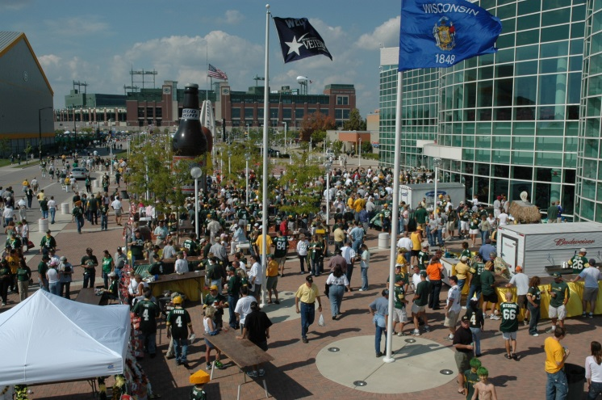
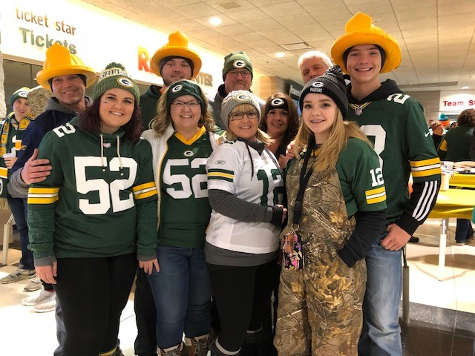
PMI ENTERTAINMENT GROUP
Event Sponsorship –Bart Starr Plaza Tailgate Party
The Bart Starr Plaza Tailgate Party is in its 18th year and has established its own legacy of tailgating success. The event begins three and a half hours prior to every Packers home game and held on the Bart Starr Plaza located in front of the Resch Center, just one block from Lambeau Field and surrounded by Ray Nitschke Field and the Don Hudson Center. In addition, 43% of fans attending the game pass through the Bart Starr Plaza Tailgate zone on their way to Lambeau Field’s Oneida Gate.
The party sees on average 10,000 fans per year.
The party offers great entertainment, prize giveaways, great food, game day drink specials and a fun atmosphere.

